Slide 1


Proudly South Africa – Maryna Calow
May 2021

Slide 2


Slide 3


Slide 4

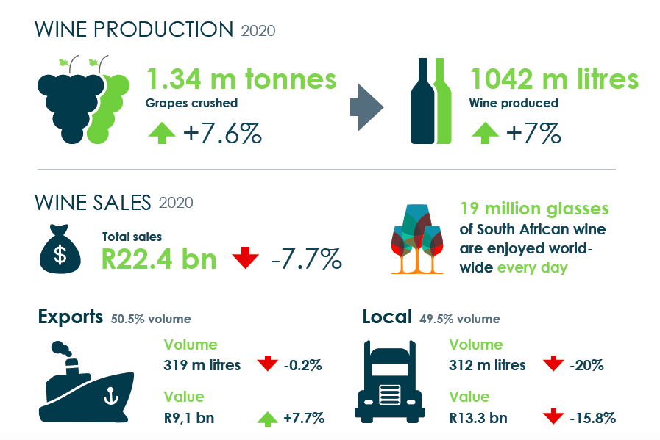

Slide 5

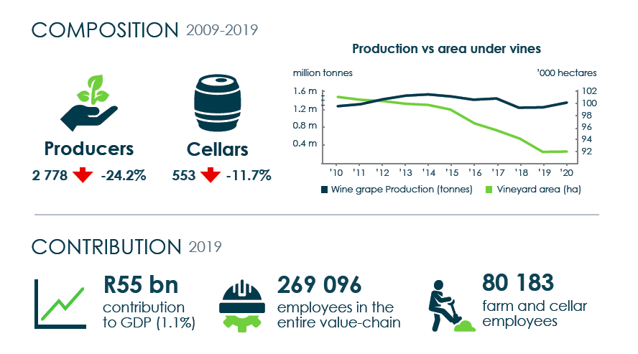

Slide 6
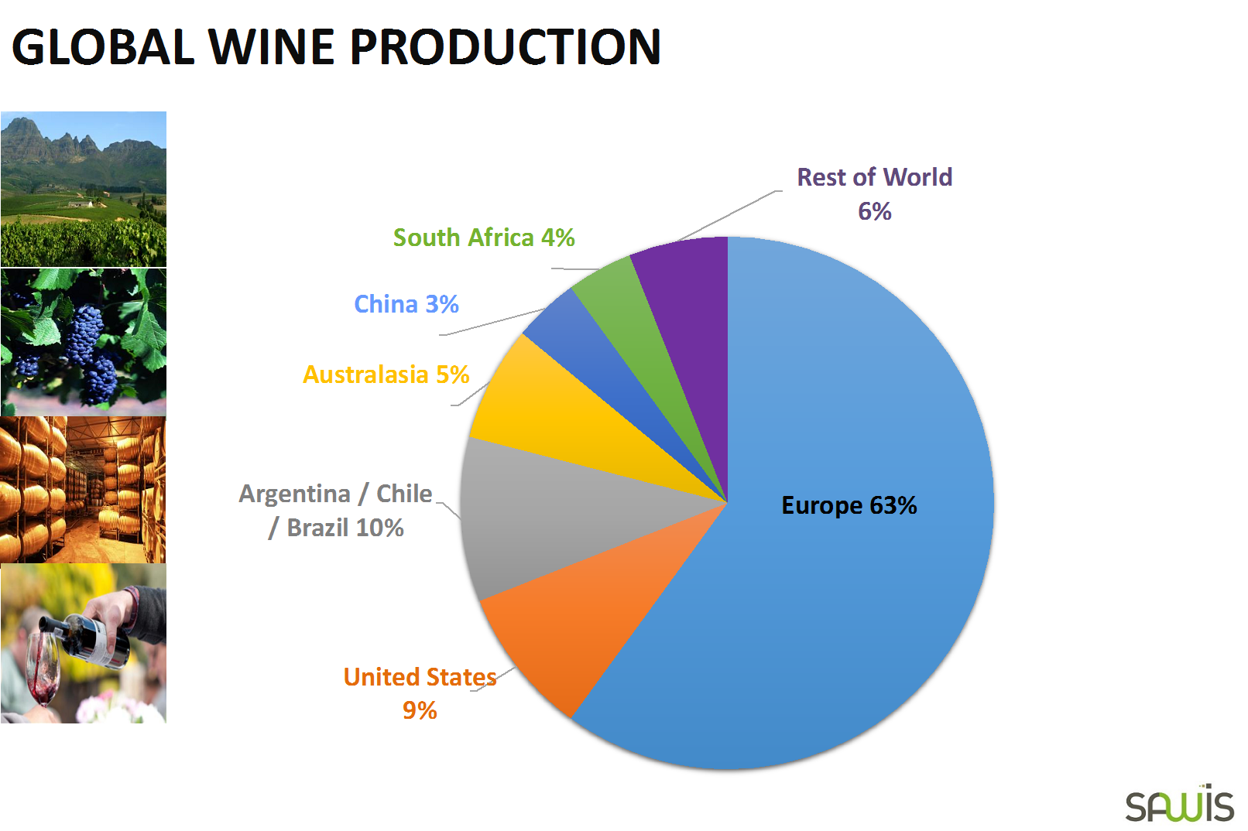
AGM 2019

Slide 7

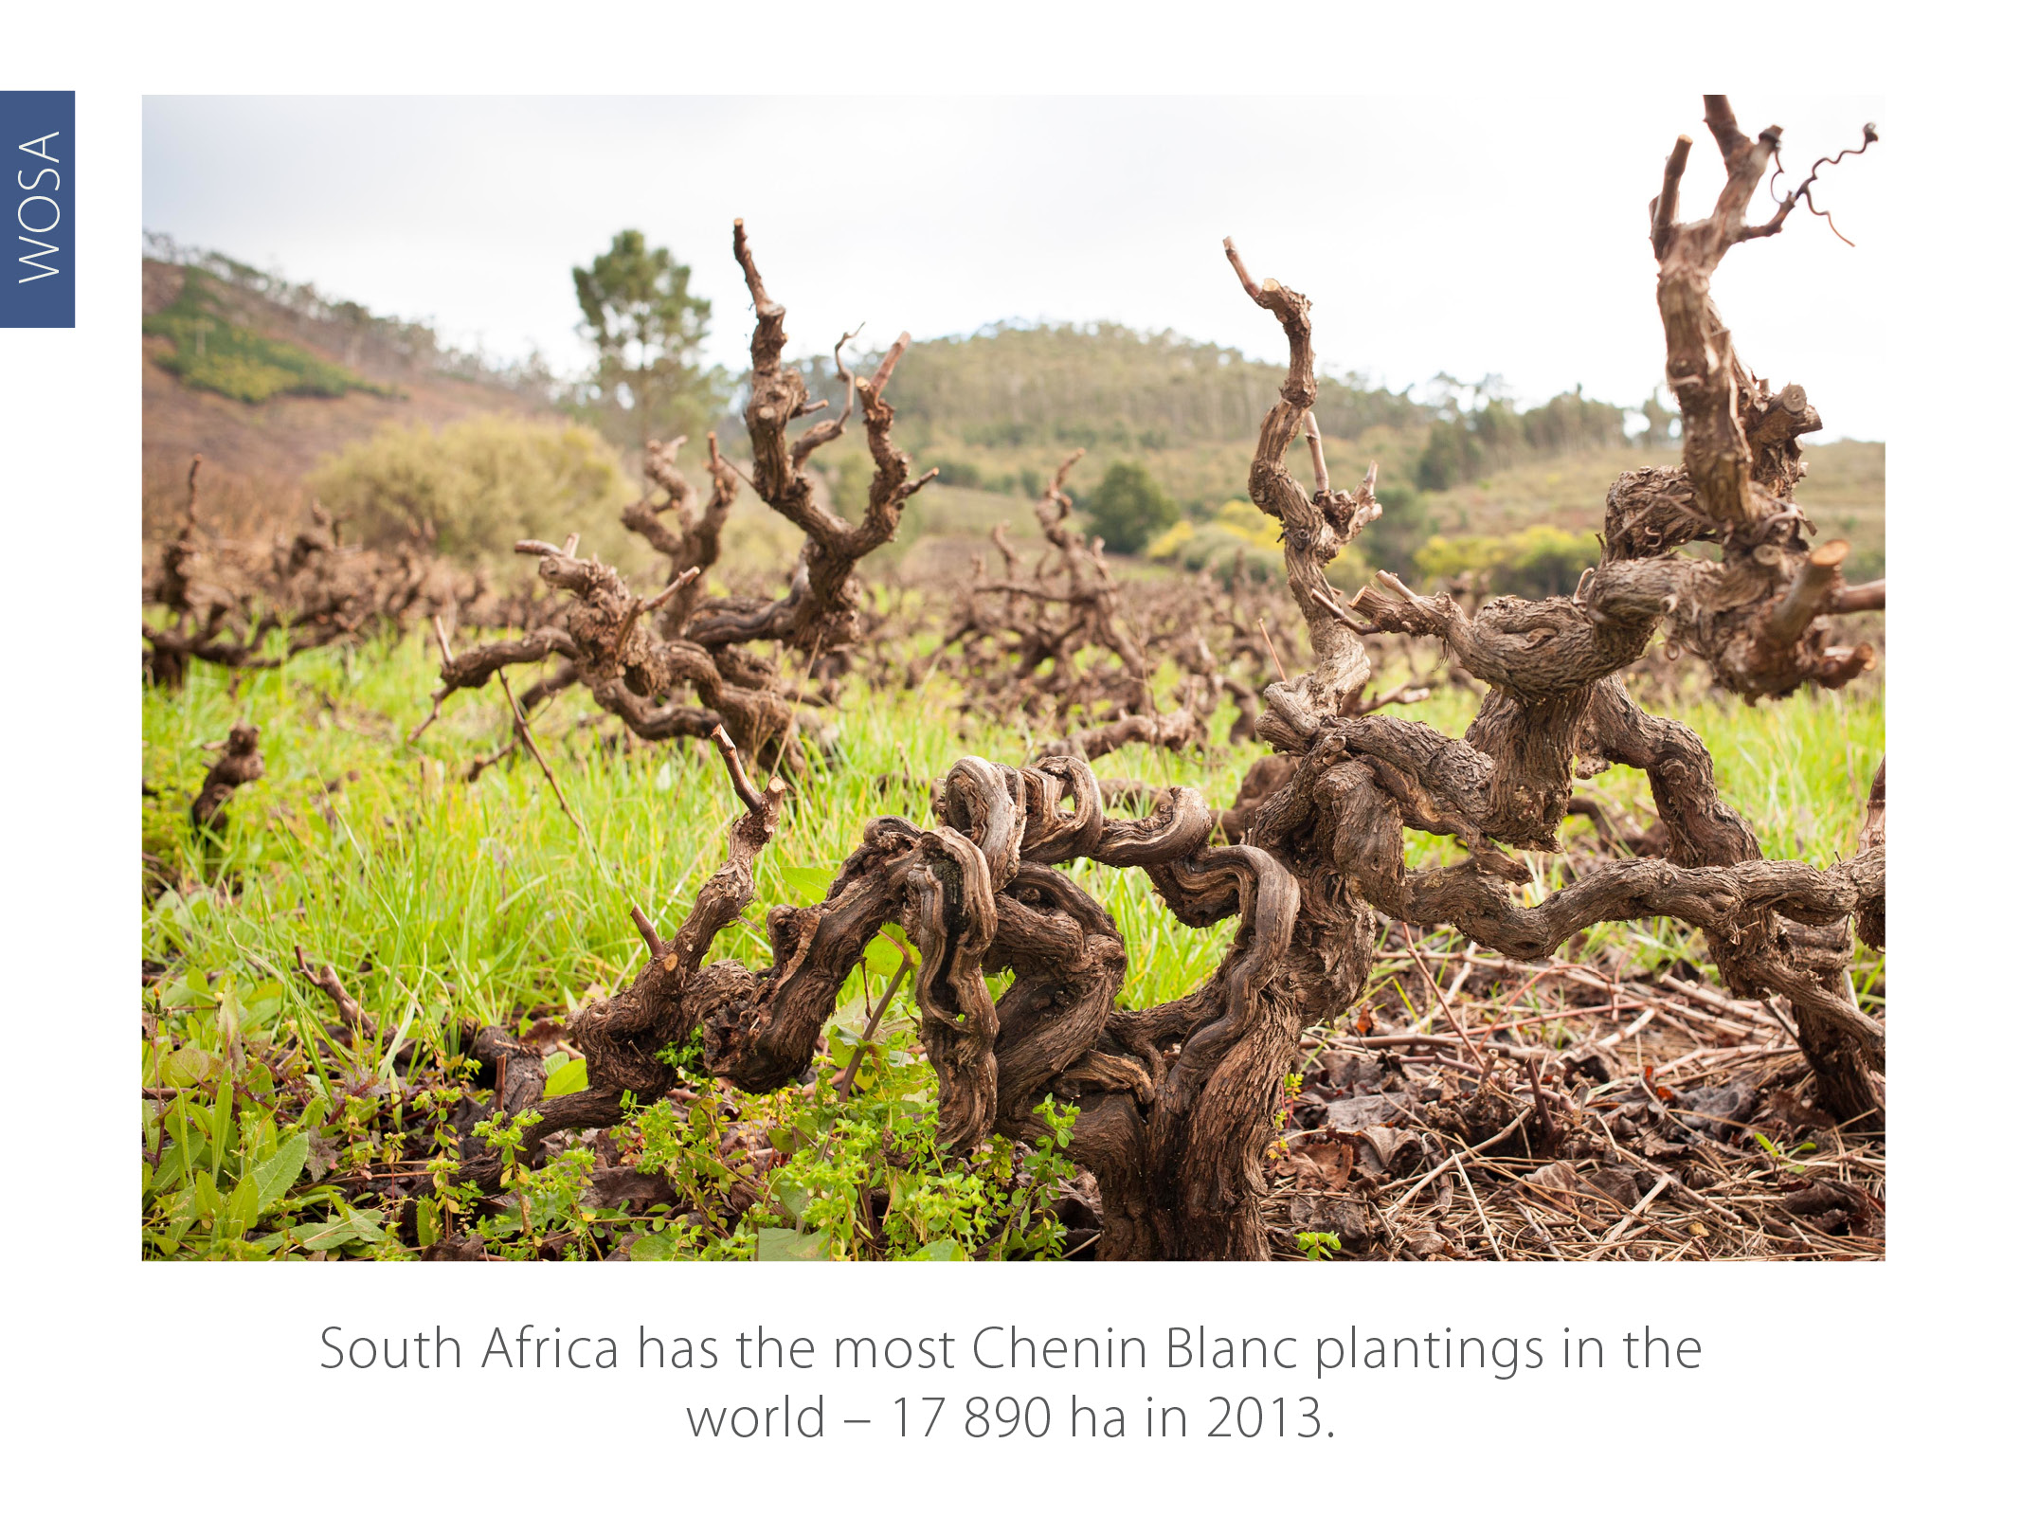
CHENIN BLANC

Slide 8

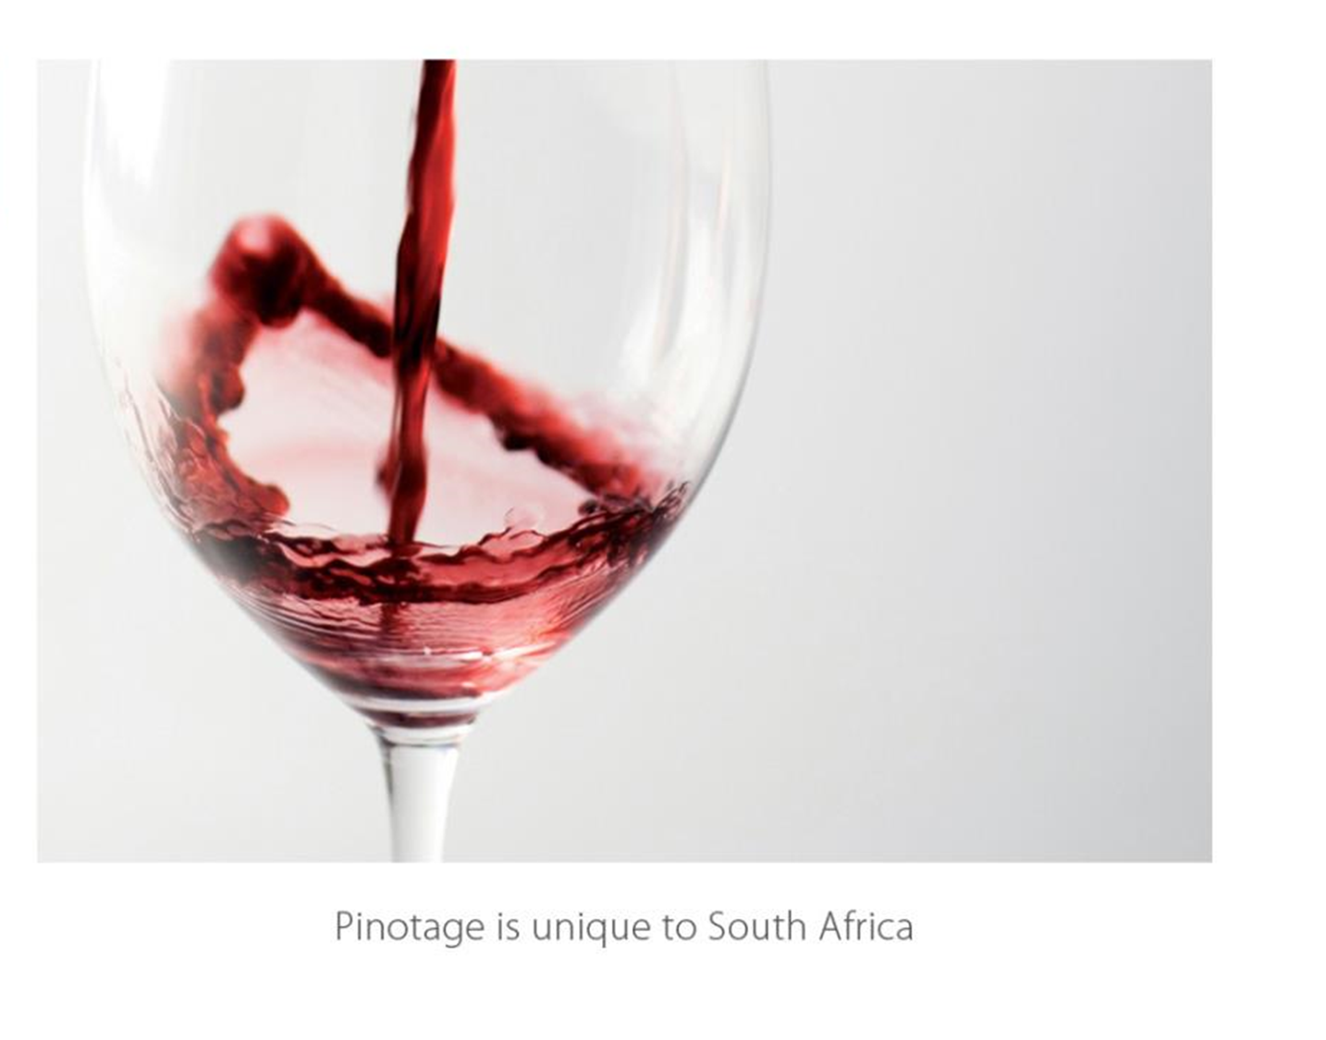

Slide 9

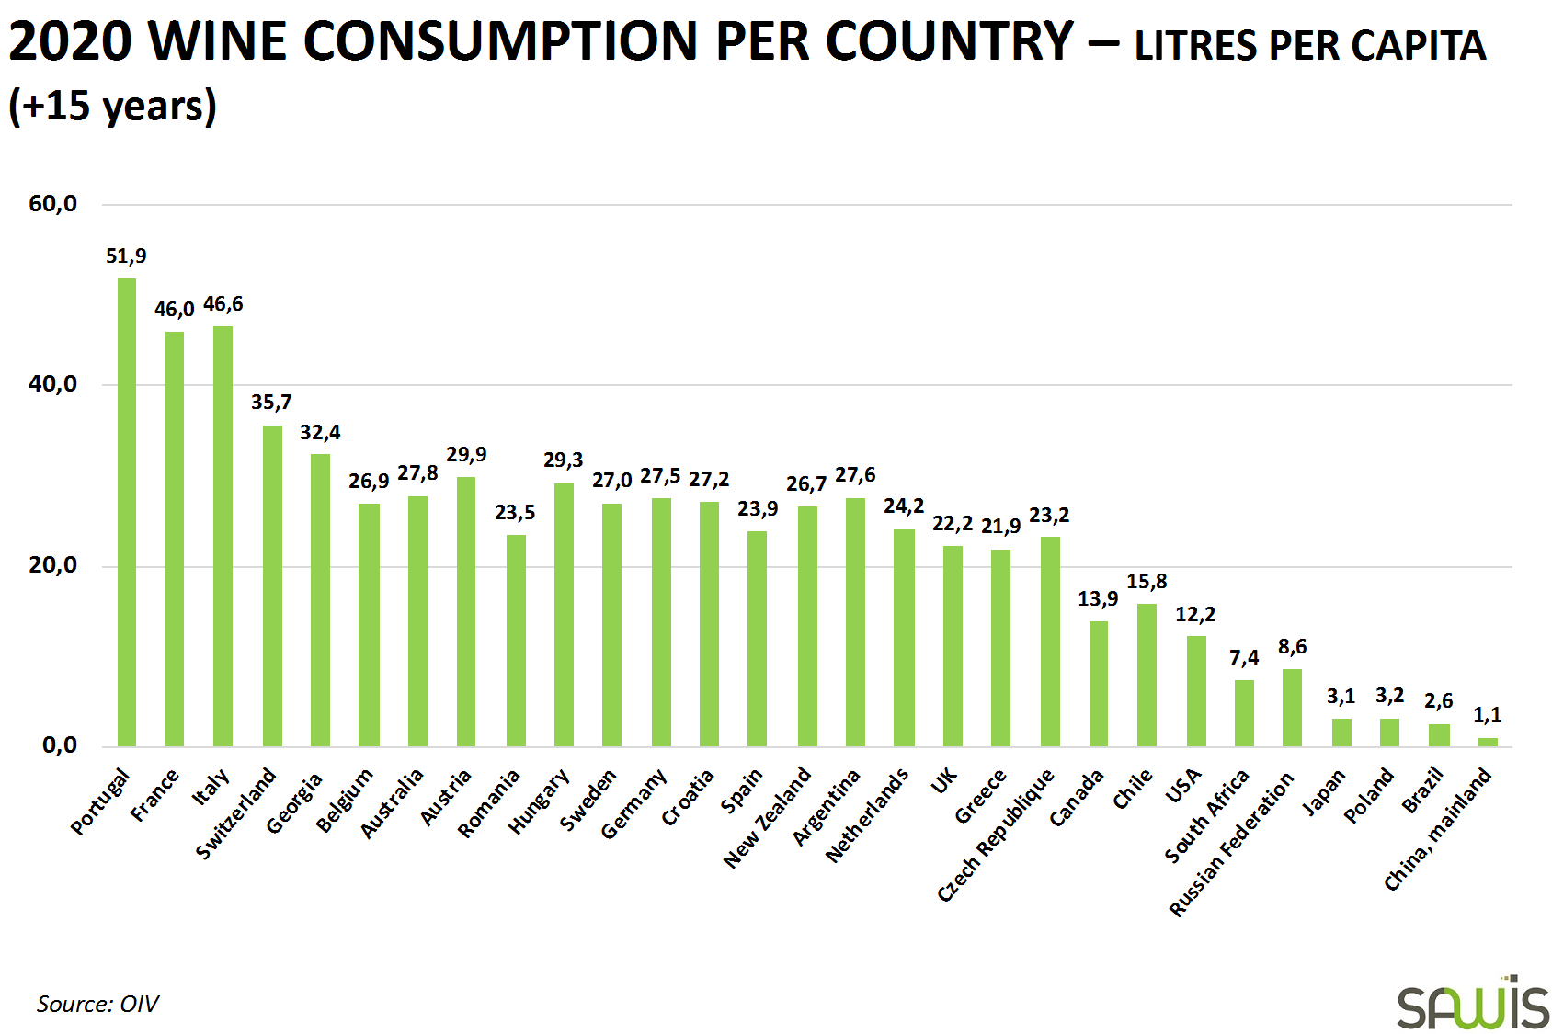

Slide 10

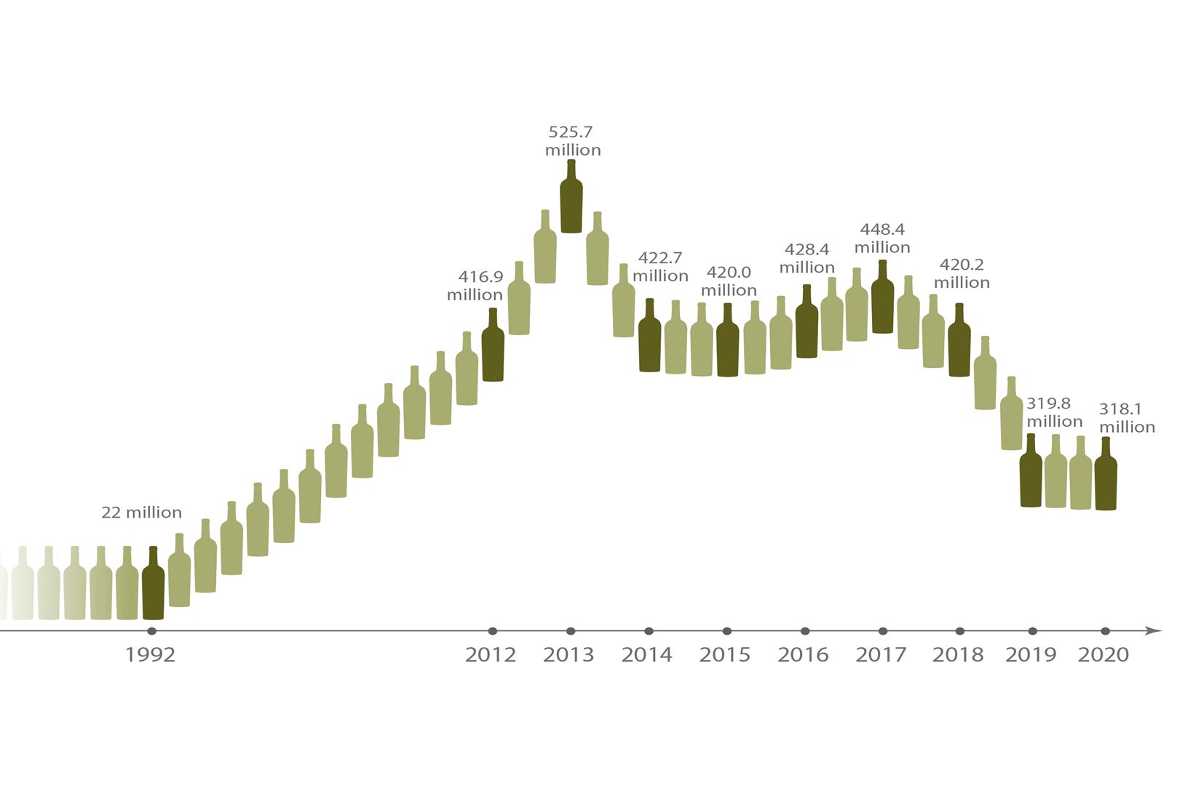

Slide 11
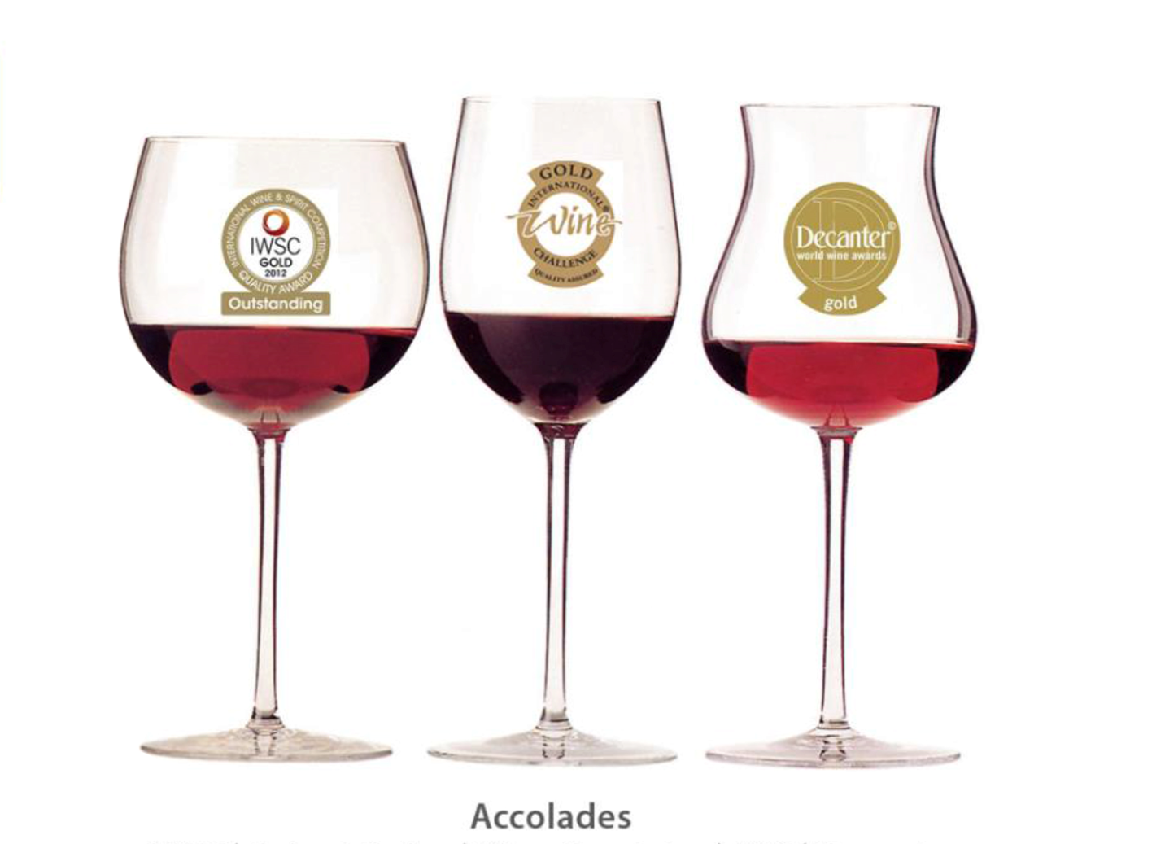

Slide 12

Maryna@wosa.co.za
Notes:
The end

